Slide 1
SASRec-based Educational Recommender System
Zimo.Wen Jiaqi.Dong Zeyuan.Zhao Yingchao.Jian

Slide 2

What course should I take next year？
http://cse583-frontend.s3-website-us-west-2.amazonaws.com/
Grade: Sophomore
Major:
Math
Interest:
Numerical Analysis
Completed courses:
MATH 100
MATH 103
MATH125
……
These are the perfect courses for you… good luck!
MATH207
MATH208
MATH209
MATH224
……..
Machine Learning

Slide 3

Additional User Case
Tony, a Computer Science professor, wants to make his classes more engaging to attract more students. Through the university's online portal, students input their interests, academic progress, and preferences to receive personalized course recommendations. Tony uses these insights to refine his course content and boost enrollment.
Inputs
User Data:
History Course: List of previously taken courses (list of strings).
Interest: List of student interests (list of strings).
Major: The student’s major (string).
Grade: The student’s grade or academic level (integer).
Outputs
Recommended Course IDs: A list of recommended course IDs (list of strings).

Slide 4





Technology in Cloud Computing: AWS
RDS
Managed Relational Database Service
AWS Glue
ETL (Extract, Transfer, Load)
S3
Scalable Storage in the Cloud
Amazon SageMaker
Build, Train and Deploy ML Models

Slide 5
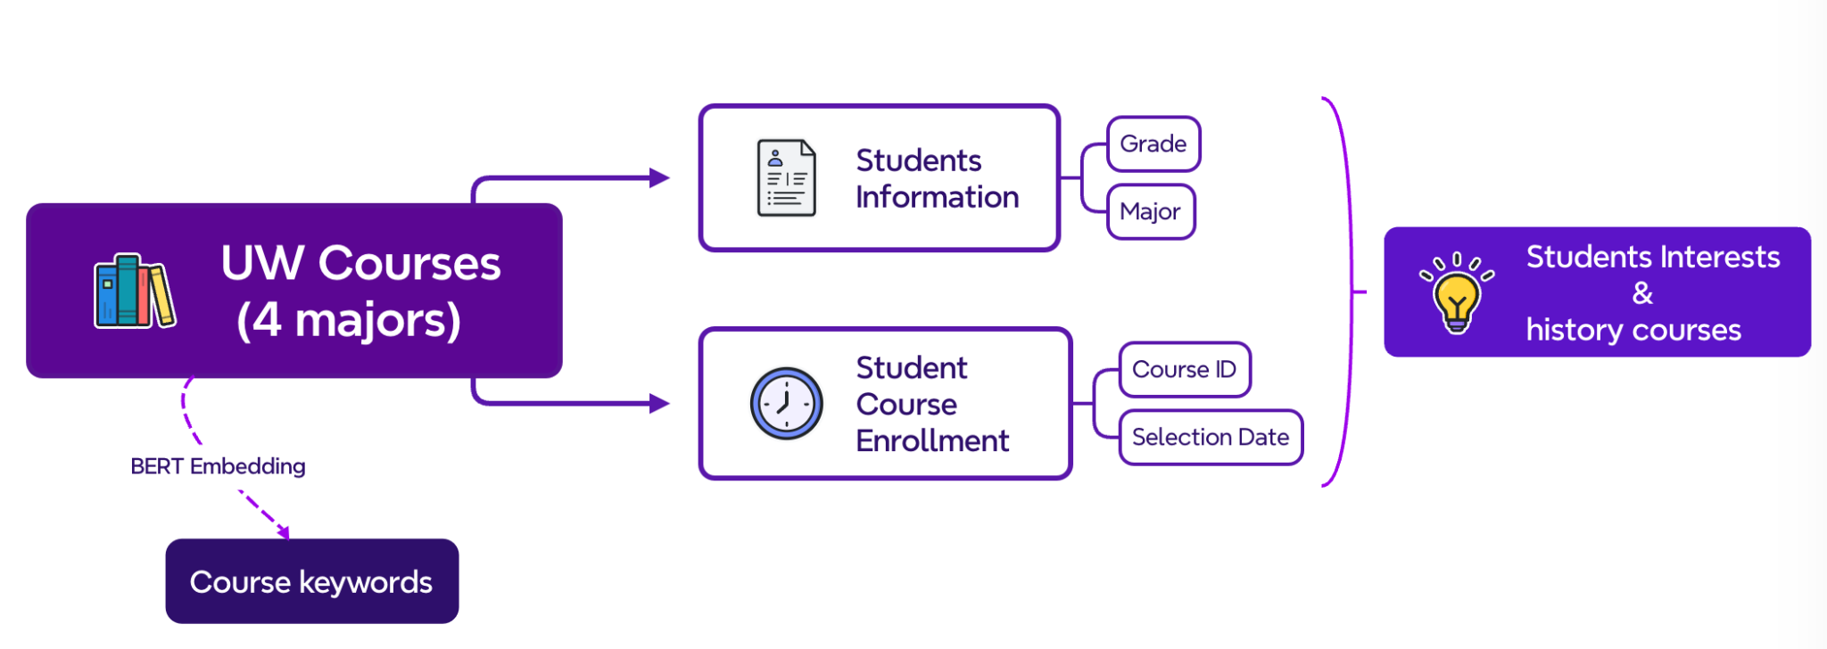
Database

Slide 6
SASRec（Self-Attention Sequence Recommendation）
Technology behind Core Model: Self-Attention, Python (scikit-learn，tensorflow)
Sequence Modeling:
Models the sequence of courses taken by a student to predict the next course.
Calculates the similarity between course keywords and student interests.
Incorporates grades and course content for richer representation.
Combines keyword match scores with model-based scores to rank courses.
Recommendation:
For each student, the model recommends a fixed number of courses based on:
Historical courses taken.
Student interests (keywords).
Learned patterns from the training data.

Slide 7
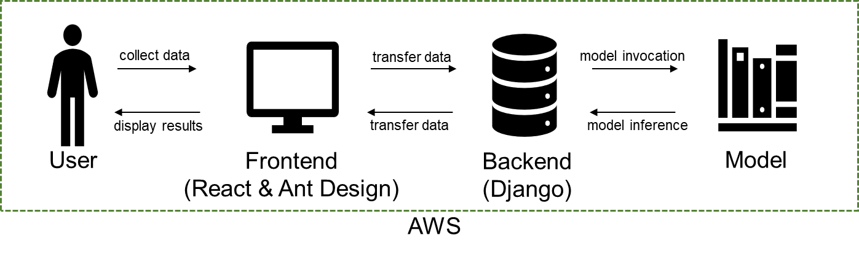
Technology for Frontend & Backend: React & Ant Design; Django
Workflow Overview
User Input: The user provides their information, including name, grade, major, interests, and course history, through the frontend interface.
Data Transfer: The user’s input is transmitted from the frontend to the backend for processing.
CORS Configuration: To handle cross-origin requests between the frontend and backend, the django-cors-headers middleware is configured in the backend. This ensures seamless communication between the two components.
Backend Validation: The backend receives the data, validates it for accuracy and completeness, and prepares it for further processing.
Recommendation Model Interaction: The backend passes the validated user data to the recommendation model, which processes the input and generates a list of recommended courses tailored to the user's profile.
Data Transmission to Frontend: The backend sends the recommended courses back to the frontend.
Displaying Recommendations: The frontend receives the data and presents the recommended courses to the user in a user-friendly format.

Slide 8
Challenge
No real dataset
Fake dataset —> low accuracy and low authenticity （The logic of course selection and the interests generation)
Limited numbers of majors and limited number of students, need more interactions between different majors
AWS Deployment and Automation
Connections between frontend, backend and the model; Automatic data collection, Seamless model updates, Full pipeline automation.
Notes:
One major challenge was the lack of a real dataset, forcing us to use fake data, which lowered the accuracy and authenticity of our course selection logic and interest generation. Additionally, the dataset was limited in the number of majors and students, restricting interactions across disciplines. Technical challenges included deploying on AWS and ensuring smooth integration between the frontend, backend, and the recommendation model.

Slide 9
Future steps
Real data from more students (more majors and more diverse interests)
More personalized course recommendations (dynamically adjusting suggestions based on students' learning goals and individual needs)
Introduce a real-time feedback mechanism (allowing students to rate the recommended courses to improve the algorithm's performance)
Add social features (such as recommending courses based on interest groups or providing opportunities for peer learning)
Notes:
Our future steps include collecting real data from more students, covering a wider range of majors and diverse interests, to improve accuracy and authenticity. We aim to provide more personalized course recommendations by dynamically adjusting suggestions based on students' learning goals and individual needs. A real-time feedback mechanism will allow students to rate courses, helping us refine the algorithm. Lastly, we plan to add social features, like course recommendations based on interest groups and opportunities for peer learning, to make the experience more engaging and collaborative.

